Slide 1
http://www.vidyanidhi.com/
ketkiacharya.net@gmail.com
Ketki Acharya
From: SM VITA ATC of CDAC
ketkiacharya.net@gmail.com

Slide 2
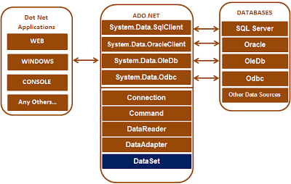

Slide 3
You can use the ADO.NET libraries in three conceptually unique manners:
connected,
disconnected, or
through the Entity Framework.

Slide 4
When you use the connected layer
your code base explicitly connects to and disconnects from the underlying data store.
When you use ADO.NET in this manner, you typically interact with the data store using
connection objects,
command objects, and
data reader objects.

Slide 5
Command
A command is, in its simplest form, a string of text containing SQL statements that is to be issued to the database.
A command could also be a stored procedure, or the name of a table that will return all columns and all rows from that table (in other words, a SELECT * - style clause).

Slide 6
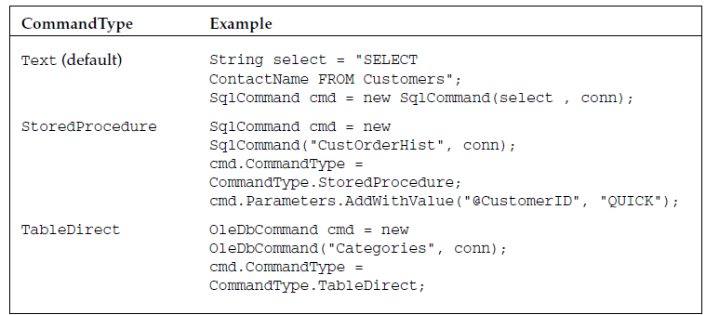
CommandType
The < provider > Command classes have a property called CommandType , which is used to define whether the command is a SQL clause, a call to a stored procedure, or a full table statement (which simply selects all columns and rows from a given table). CommandType enumeration.

Slide 7
Demo connected layer
using System;
using System.Data.SqlClient;
namespace ADO01_ConsoleApplication
{
public class Productlayer
{
public void Products()
{
string connectionString = @"data source=.\SQLExpress;database=Sample; integrated security=true";
using (SqlConnection con = new SqlConnection(connectionString))
{
// Pass the connection to the command object, so the command object knows on which
// connection to execute the command
SqlCommand cmd = new SqlCommand("Select * from Product", con);
// Open the connection. Otherwise you get a runtime error. An open connection is
// required to execute the command
con.Open();
Console.WriteLine("connected");
SqlDataReader rdr = cmd.ExecuteReader(); //returns object of sqldatareder
if (rdr.HasRows)
{
while (rdr.Read())
{
Console.WriteLine("{0} {1} {2} {3}", rdr["Id"], rdr["Name"], rdr["Price"], rdr["Qty"]);
}
}
}
}
}

Slide 8
SSPI stands for Security Support Provider Interface.
The SSPI allows an application to use any of the available security packages on a system without changing the interface to use security services. The SSPI does not establish logon credentials because that is generally a privileged operation handled by the operating system.
Other than SSPI you can also use "true". Integrated Security actually ensures that you are connecting with SQL Server using Windows Authentication, not SQL Authentication; which requires username and password to be provided with the connecting string.

Slide 9
SqlConnection con = new SqlConnection(connectionString)
ConnectionString=“”
Open()
con
CommandText=“Select * fromproduct ”
ExecuteReader();
return new SqlDataReader()
cmd
con
bool read()
id | name | price
rdr
SqlCommand cmd = new SqlCommand("Select * from Product", con);
SqlDataReader rdr = cmd.ExecuteReader();

Slide 10
Intialised using construct or through set property
String cs = "data source=.; database=Sample; integrated security=SSPI";
SqlConnection con = new SqlConnection(cs);
String cs = "data source=.; database=Sample; integrated security=SSPI";
SqlConnection connection = new SqlConnection();
connection.ConnectionString = cs;
In above line we are using setter property to set connection string.

Slide 11
Intialised using constructor through set property
SqlCommand cmd = new SqlCommand("Select * from Product", con);
SqlCommand cmd = new SqlComand();
cmd.CommandText = "select * from tblproduct";
cmd.Connection = con;

Slide 12
There are 2 issues with hard coding the connection strings in application code
1. For some reason, if we want to point our application to a different database server, we will have to change the application code. If you change application code, the application requires a re-build and a re-deployment which is a time waster.
2. All the pages that has the connection string hard coded needs to change. This adds to the maintenance overhead and is also error prone.
In real time, we may point our applications from time to time, from Development database to testing database .
Because of these issues, the best practice is to store the connection in the configuration file, from which all the pages can read and use it. This way we have only one place to change, and we don't have to re-build and re-deploy our application. This saves a lot of time.

Slide 13
Better approach
The configuration file in a Console application is App.config.. The ConfigurationManager class can be used to read connection string from App.config file
Put following line in App.config
<connectionStrings>
<add name="DatabaseConnectionString"
connectionString="data source=.; database=Sample_Test_DB; Integrated Security=SSPI"
providerName="System.Data.SqlClient" />
</connectionStrings>

Slide 14
How to read/Link app.config
using System.Configuration;
string connectionString = ConfigurationManager.ConnectionStrings["DatabaseConnectionString"].ConnectionString;

Slide 15
< provider > Command classes provide the following execute methods:
ExecuteNonQuery() — Executes the command but does not return any output returns the number of rows affected by the command as an int eg:insert,update,delete
ExecuteReader() — Executes the command and returns a typed IDataReader This method executes the command and returns a typed data reader object, depending on the providerin use
eg:select
ExecuteScalar() — Executes the command and returns a single value. return a single result from a SQL statement, such as the count of records in a given table, or the current date/time on the server
eg:count,sum,etc
ExecuteXmlReader() — Executes the command and returns an XmlReader object, which can be used to traverse the XML fragment returned from the database

Slide 16
Fast Data Access: The Data Reader
it is also the least capable. You cannot directly instantiate a data reader object — an instance is returned from the appropriate database ’ s command object (such as SqlCommand ) after having called the ExecuteReader() method.
DataReader is a forward - only “ connected ” cursor. In other words, you can only traverse the records returned in one direction, and the database connection used is kept open until the data reader has been closed.

Slide 17
The disconnected layer
It allows you to manipulate a set of DataTable objects (contained within a DataSet) that functions as a client-side copy of the external data. When you obtain a DataSet using a related data adapter object, the connection is automatically opened and closed on your behalf.
As you would guess, this approach helps free up connections for other callers quickly and goes a long way toward increasing the scalability of your systems

Slide 18
Entity Framework
Using EF, you are able to interact with a relational database using client-side objects that encapsulate a number of low-level database specifics from view.
As well, the EF programming model allows you to interact with relational databases using strongly typed LINQ queries, using the grammar of LINQ to Entities.

Slide 19
ADO.NET ships with four database client namespaces:
SQL Server,
Oracle,
ODBC data sources,
any database exposed through OLE DB.
If your database of choice is not SQL Server or Oracle, use the OLE DB route unless you have no other choice than to use ODBC

Slide 20
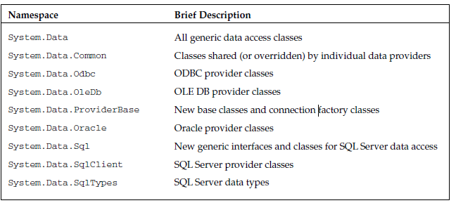
Namespaces

Slide 21
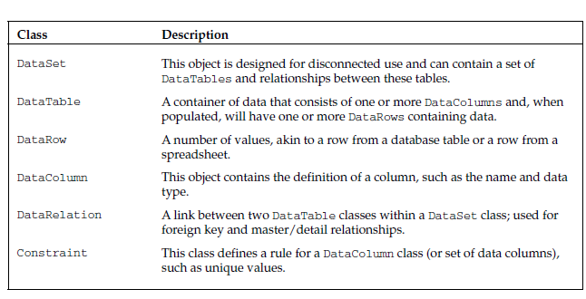
Shared Classes

Slide 22
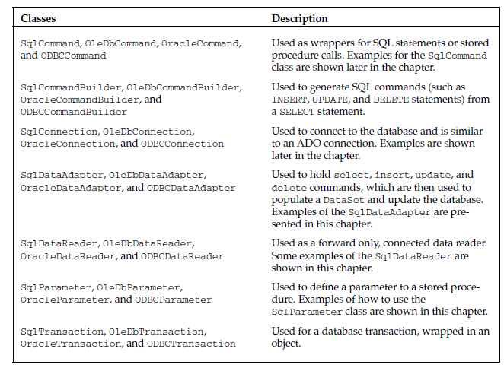

Slide 23
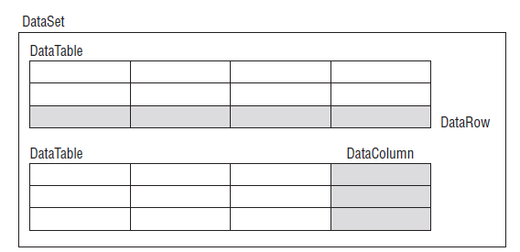
DataSet Class
A DataSet class consists of a set of data tables, each of which will have a set of data columns and data rows

Slide 24
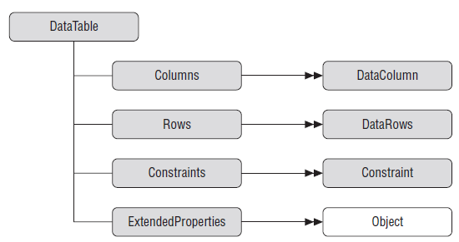
Data Tables

Slide 25
Disconnected Architecture
public class Product
{
public void displayproduct()
{
// Create an instance of SqlDataAdapter. Spcify the command and the connection
string ConnectionString = ConfigurationManager.ConnectionStrings["DatabaseConnectionString"].ConnectionString;
SqlConnection connection = new SqlConnection(ConnectionString)
SqlDataAdapter dataAdapter = new SqlDataAdapter("select * from Product", connection);
// Create an instance of DataSet, which is an in-memory datastore for storing tables
DataSet dataset = new DataSet();
// Call the Fill() methods, which automatically opens the connection, executes the command
// and fills the dataset with data, and finally closes the connection. //no open method
dataAdapter.Fill(dataset);
Console.WriteLine(dataset.GetXml());
dataset.Tables[0].TableName = "Products";
DataTable dt = dataset.Tables["Products"];
// DataTable dt = dataset.Tables[0];
foreach (DataRow row in dt.Rows)
{
foreach (DataColumn col in dt.Columns)
Console.Write(row[col] +" ");
Console.WriteLine("----------------------------------");
}
}
}

Slide 26
SqlConnection connection = new SqlConnection(ConnectionString)
con
ConnectionString=“”
SqlDataAdapter dataAdapter = new SqlDataAdapter("select * from Product", connection);
dataAdapter
("select * from Product",
connection
fill(dataset)
id | name | price
dataset

